Slide 1
Customer retention Project
A case study from Indian e-commerce customers
BY Saket Mirajgave

Slide 2
Business Problem Framing & Conceptual Background of the Domain Problem
Problem Statement: Analyse the Features affecting Customer Satisfaction & retention and test if brand preference depends on factors like age and gender.
The combination of both utilitarian value and hedonistic values are needed to affect the repeat purchase intention (loyalty) positively.
The data is collected from the Indian online shoppers. Results indicate the e-retail success factors, which are very much critical for customer satisfaction.

Slide 3
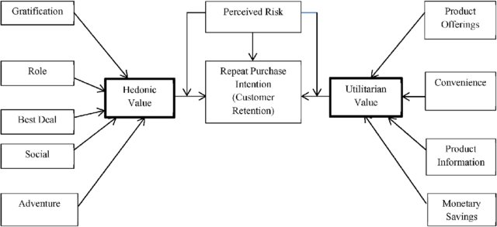
Process Flow Chart
Flow Chart of the Process Involved in the Customer Retention

Slide 4
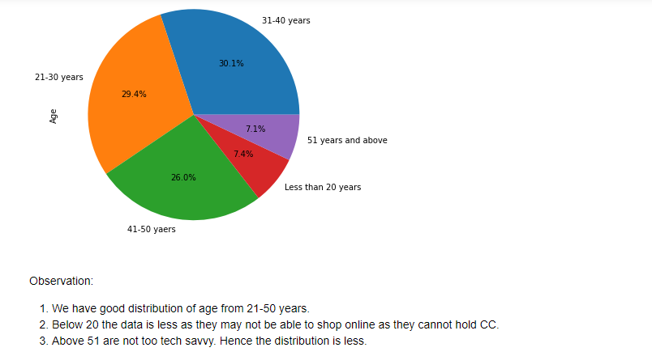
Age group

Slide 5
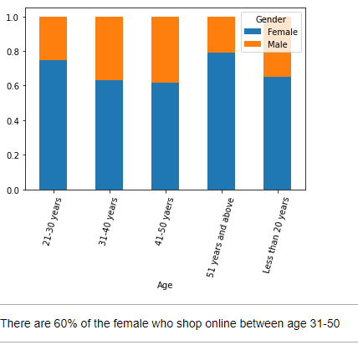
Age v/s gender

Slide 6
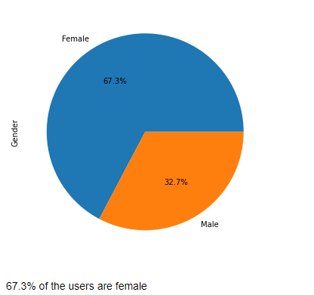
Gender

Slide 7
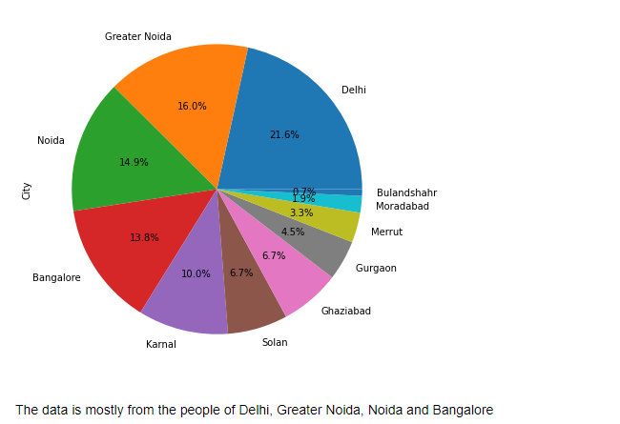
City

Slide 8
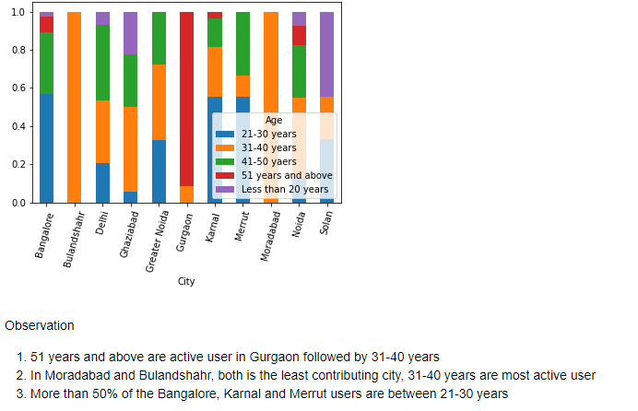
City vs age

Slide 9
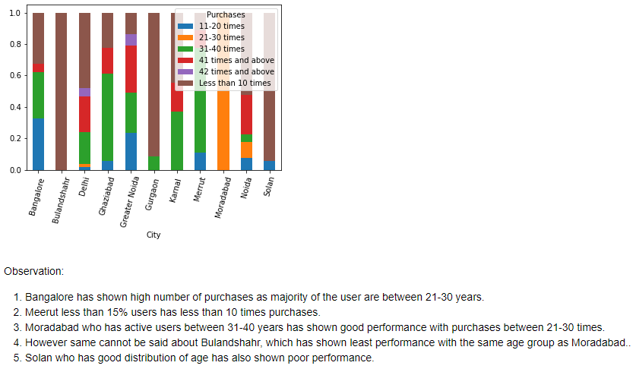
City vs purchases in last 1 year

Slide 10
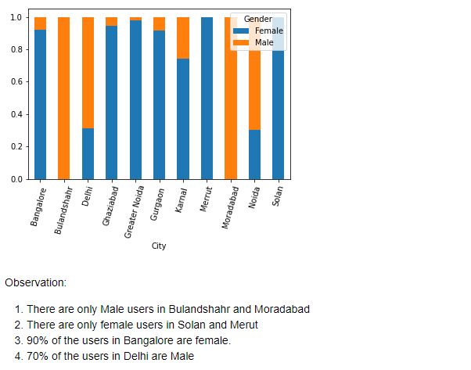
City vs gender

Slide 11
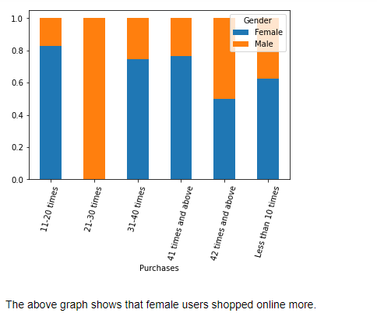
Gender vs purchases made in last 1 year

Slide 12
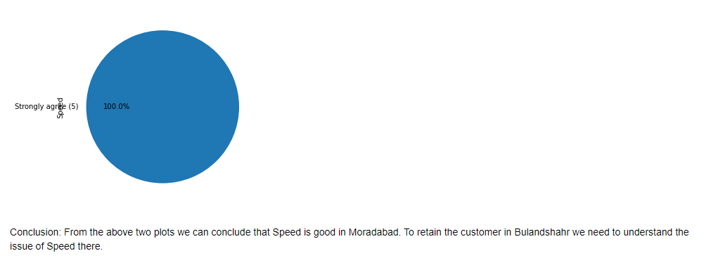
City Moradabad vs processing speed

Slide 13
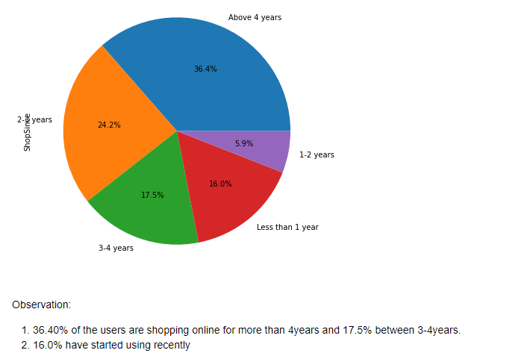
Shopping since

Slide 14
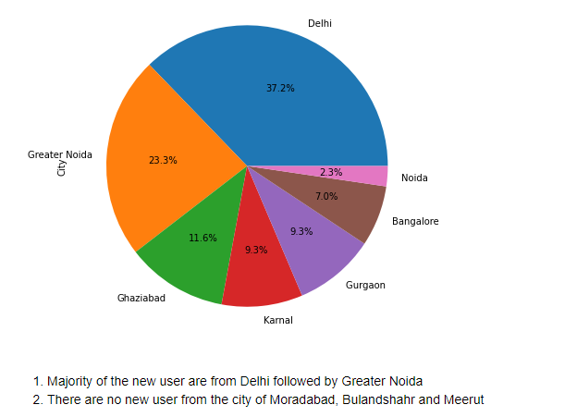
City vs shopping since last 1 year

Slide 15
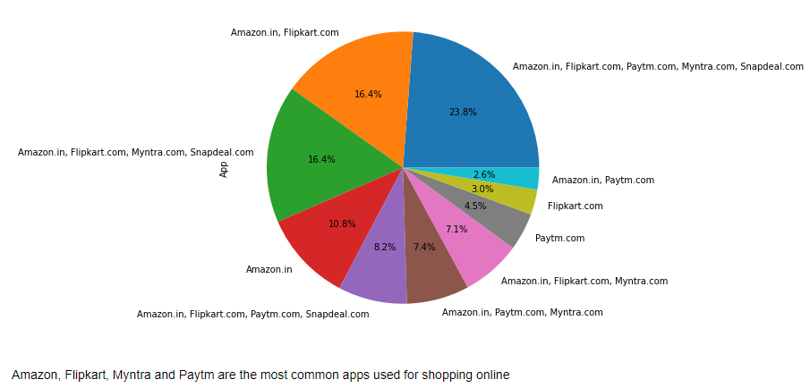
Easy to use application

Slide 16
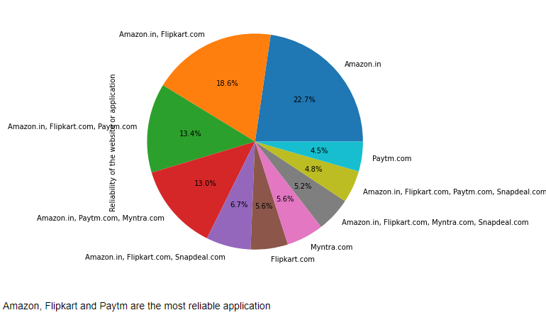
Reliable application

Slide 17
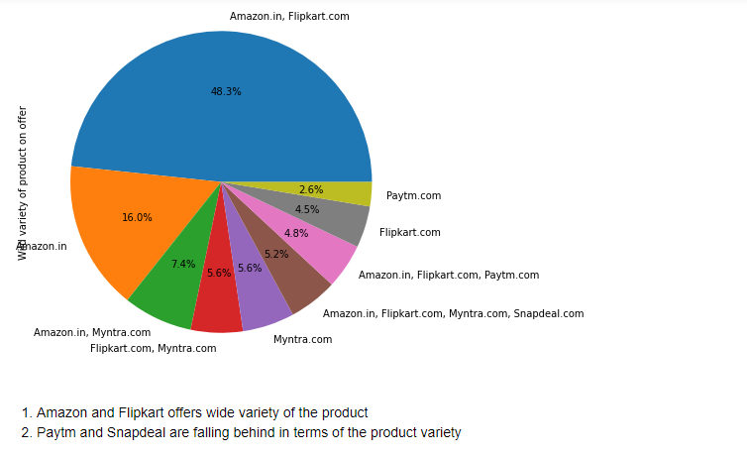
Wide variety of product

Slide 18
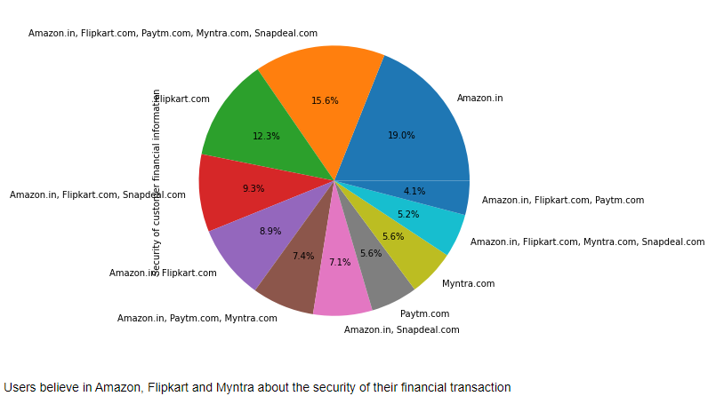
Security of the financial transaction

Slide 19
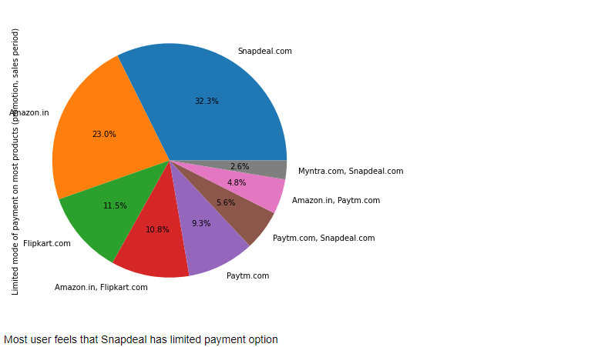
Limited payment option

Slide 20
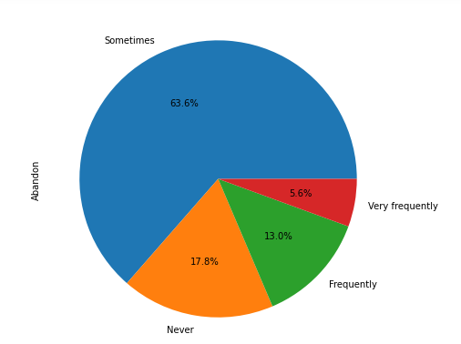

How frequently do you user abandon their cart

Slide 21
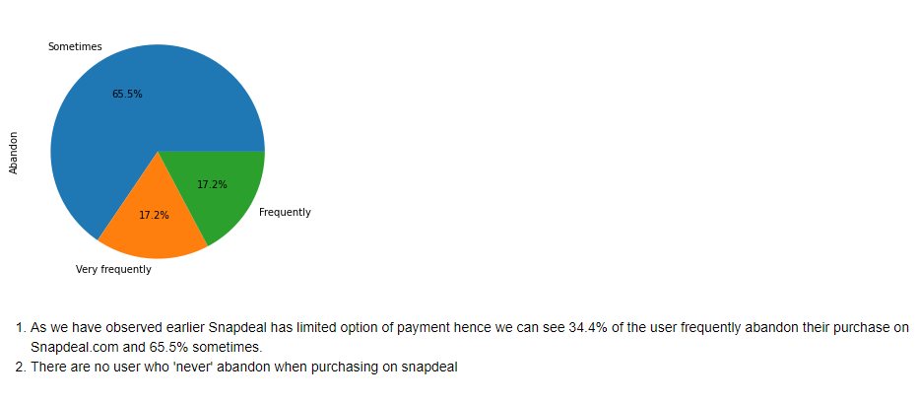
Limited payment option vs abandoning the cart (snapdeal)

Slide 22
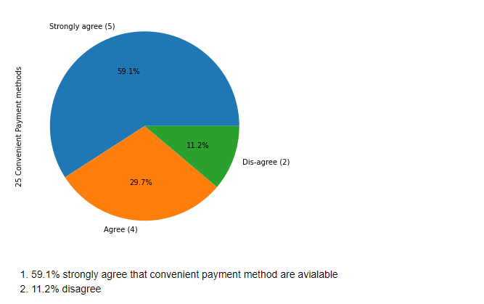
Convenient payment option

Slide 23
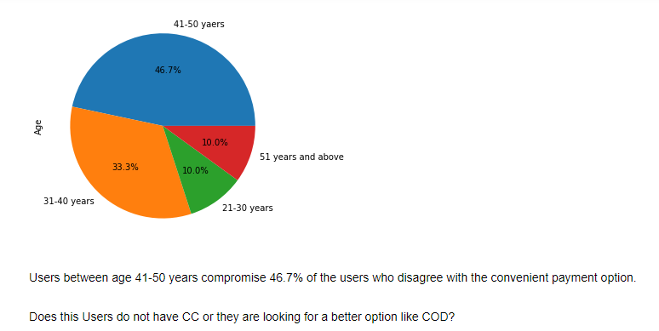
Convenient payment vs age

Slide 24
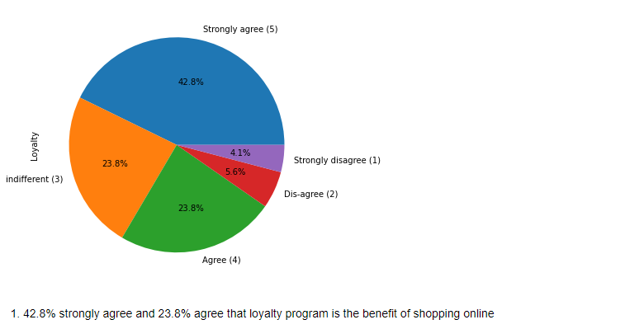
Loyalty

Slide 25
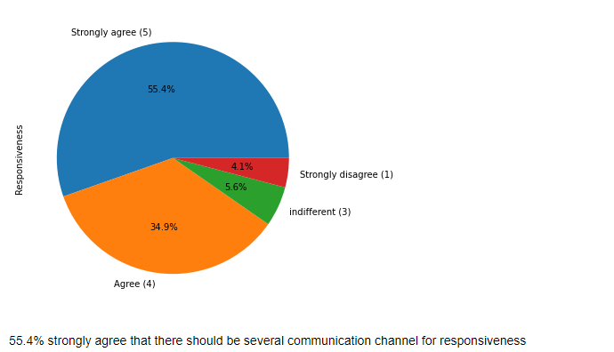
Responsiveness

Slide 26
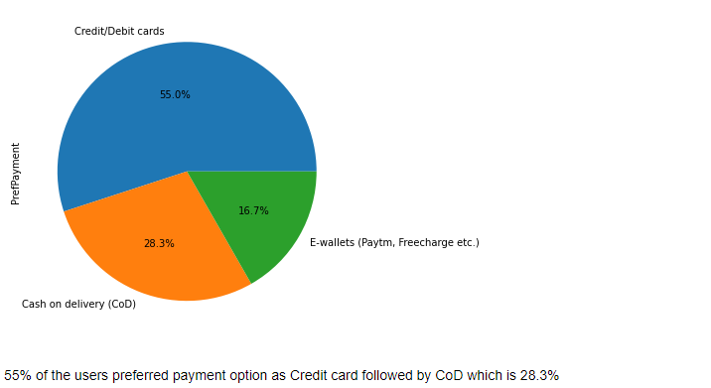
Preferred payment option

Slide 27
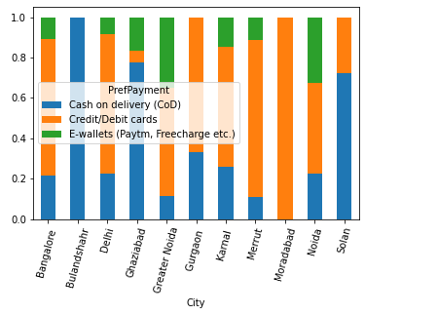
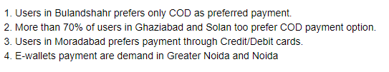
Payment option vs city

Slide 28
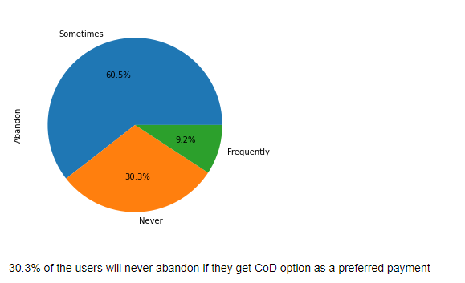
Abandon vs preferred payment(cod)

Slide 29
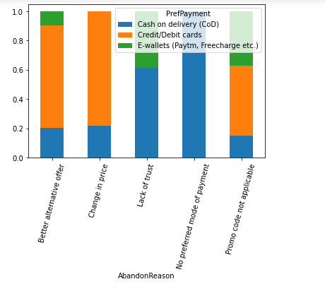
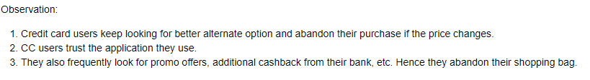
Abandon reason vs preferred payment

Slide 30
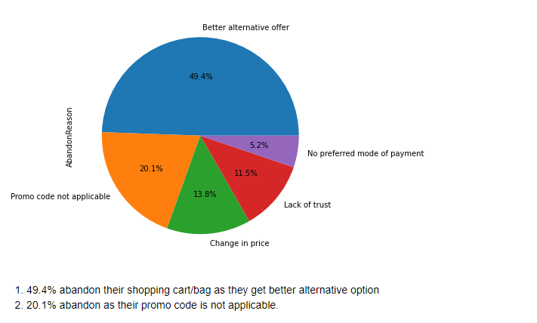
Abandon reason

Slide 31
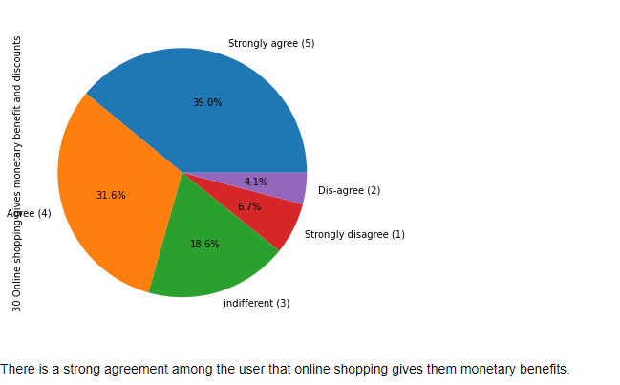
Monetary benefits

Slide 32
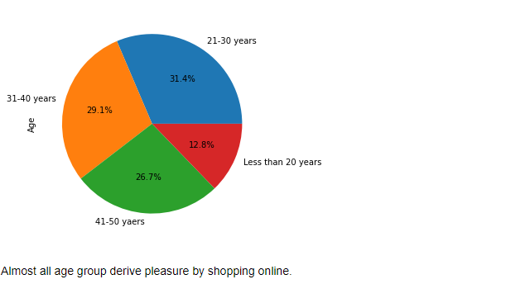
Enjoying shopping vs age

Slide 33
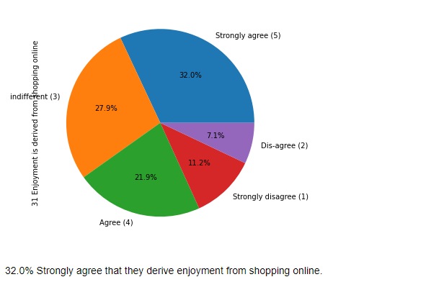
Enjoyment from shopping

Slide 34
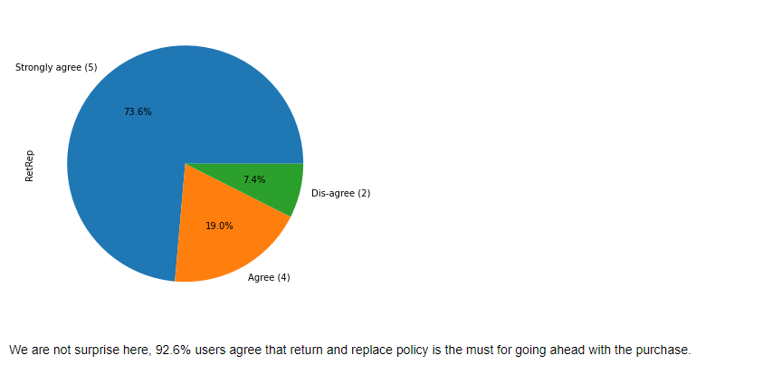
Return/exchange policy

Slide 35
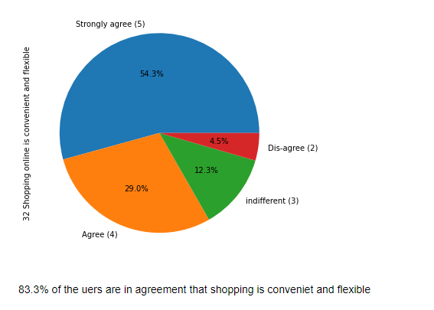
Convenience

Slide 36
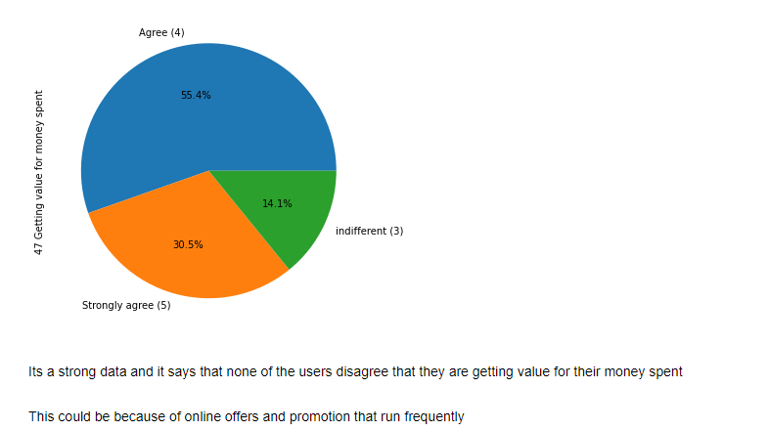
Value for money

Slide 37
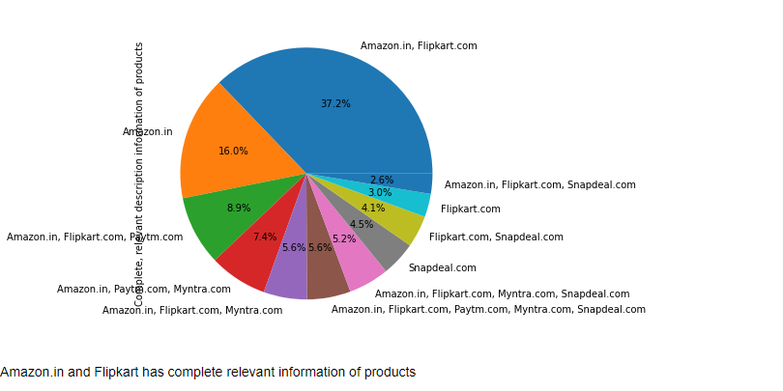
Relevant information about the products

Slide 38
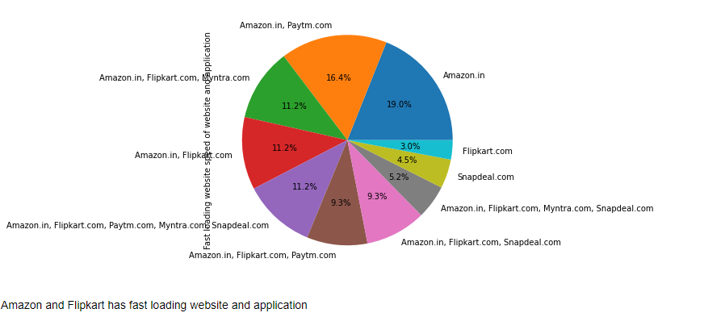
Fast loading website/application

Slide 39
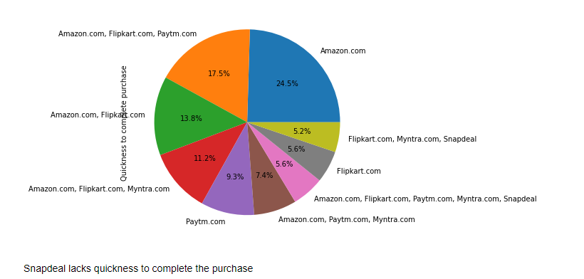
quickness

Slide 40
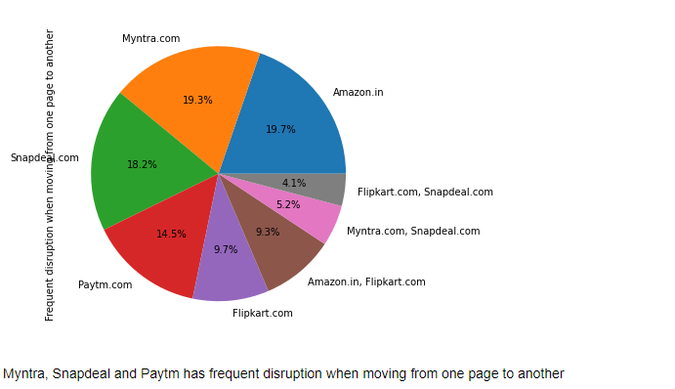
Frequent disruption from moving one page to other

Slide 41
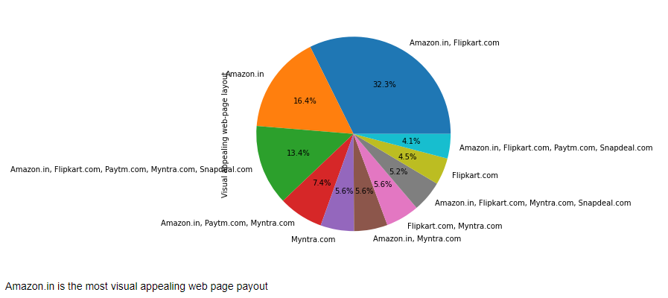
Visual appealing website

Slide 42
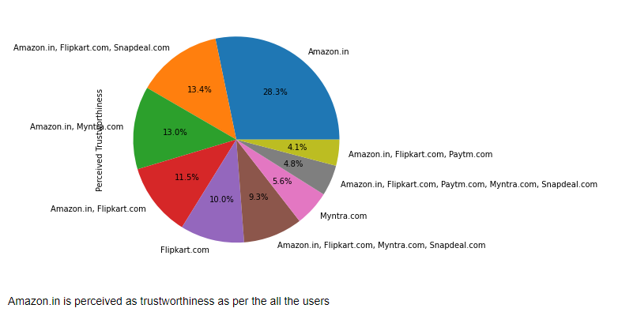
Trustworthiness

Slide 43
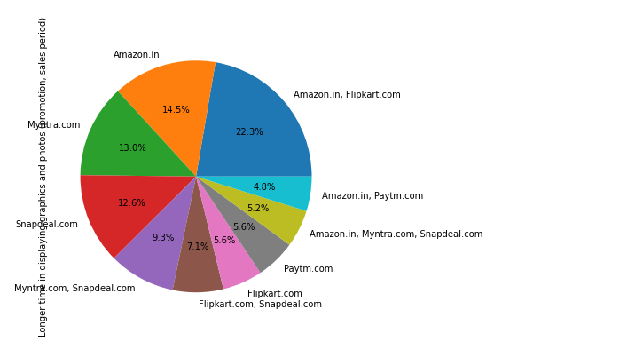
Longer time in displaying graphics

Slide 44
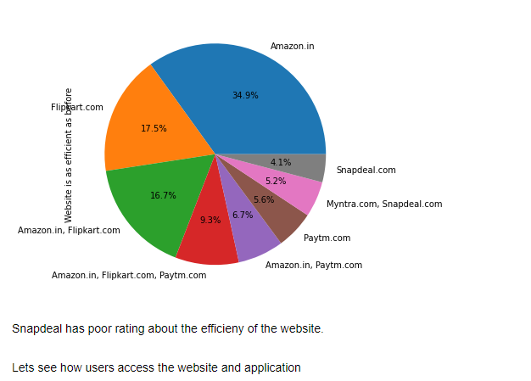
Efficiency of the website

Slide 45
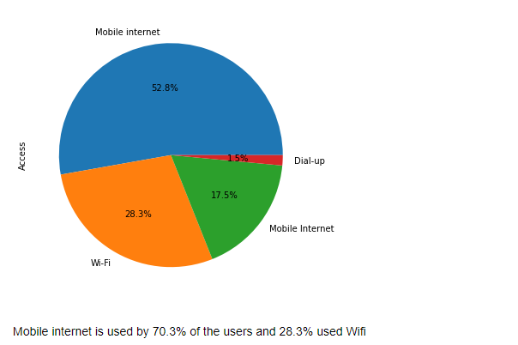
Accessibility

Slide 46
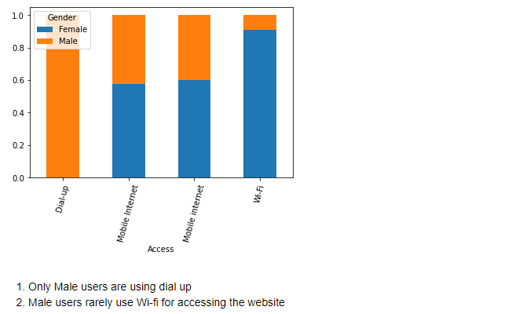
Accessibility vs gender

Slide 47
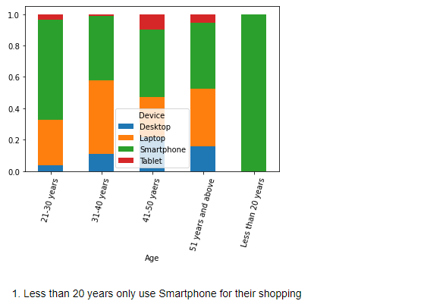
Device vs age

Slide 48
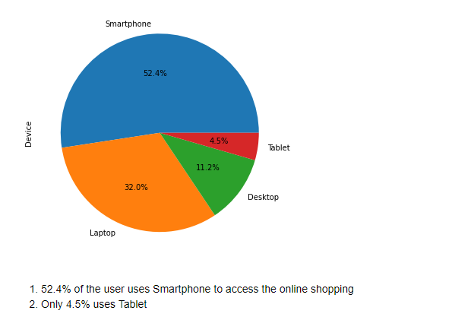
Device

Slide 49
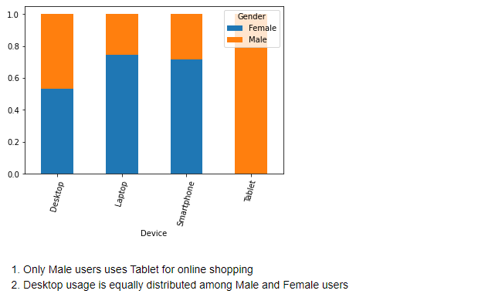
Device vs gender

Slide 50
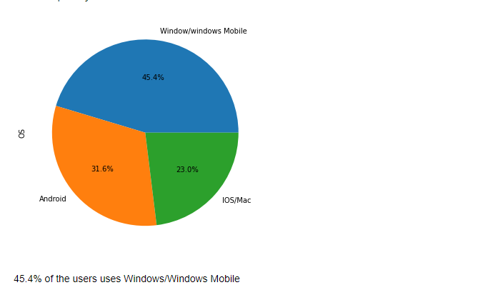
Operating system

Slide 51

Browser (firefox) vs frequent disruption

Slide 52

Browser

Slide 53

Recommending

Slide 54
Conclusion
Customer satisfaction is important to win the customer back. There is lot of competition in e-commerce space of retailers hence company should focus in offering the best service.
Convenience
The interface should be user friendly. There should be complete description of the product on the website or application and it should be efficient to use.
Security
Company should win customer trust that their personal and financial details are secure with us and will not be used for any fraudulent activity.
Loyalty
One of the best way to retain the customer is to have a rewarding loyalty program. Customer should feel invested in the company and they will be happy that every purchase they are making will lead to more rewarding experience.
Technical
Any issue while browsing should be addressed. Customer may lose out on the deal if there is some glitches or technical issue with the website. The browsing should be quick especially during the sale or promotion period.

